Slide 1

PICTURE PERCEPTION
Semester 3 - Professional Communication Skills (303193203)

Slide 2
Topics to be Covered
Learning Objectives
What is Picture Perception
Importance for Engineers
Observation Skills: Step 1
Interpretation Skills: Step 2
Story Building: Step 3
The PPDT Method
Tips to Improve Picture Perception
Common Mistakes
Picture Perception in Professional Settings
Activity
Summary
Learning Outcomes

Slide 3
Learning Objectives
Understand the concept and process of picture perception.
Analyze visual stimuli critically and systematically.
Build coherent and creative narratives based on visual inputs.
Enhance observation, interpretation, and imagination skills.

Slide 4
What is Picture Perception?
A method of evaluating a person’s thinking process through a visual scene.
Commonly used in:
SSB Interviews (Armed Forces)
Management Aptitude Tests
Psychological Assessments
Combines observation, imagination, and narrative building.

Slide 5
Importance for Engineers
Improves critical thinking: vital for problem-solving.
Enhances communication clarity: especially when explaining concepts.
Boosts team collaboration: understanding others' viewpoints.
Useful in GDs, Interviews, and Tech Presentations.

Slide 6
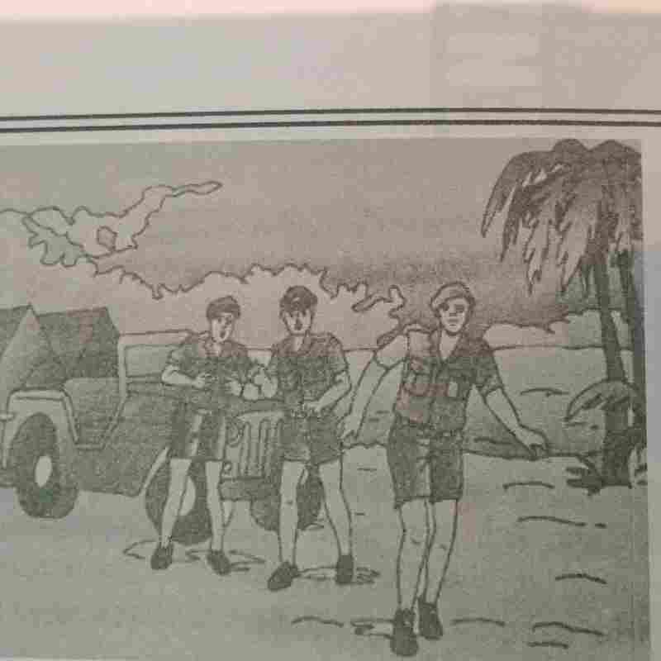
Observation Skills: Step 1
What to Observe:
Number of characters
Age, gender, mood
Environment or setting
Objects or actions in the image
Time of the day
Tip: Always observe from the whole to parts approach.

Slide 7

Interpretation Skills: Step 2
Questions to Ask Yourself:
What is happening in the picture?
What could have happened before and after this moment?
What role could each character be playing?
Exercise: Write a one-line interpretation.

Slide 8
Story Building: Step 3
Create a story based on the picture using the BME Model:
Beginning – Set the scene (who, where, when)
Middle – Describe the situation, conflict, or event
End – Resolve the situation positively or thoughtfully
🧾 Tips for Writing:
Keep it realistic and logical
Use clear language
Highlight a positive outcome or lesson

Slide 9
The PPDT Method (Picture Perception and Discussion Test)
Common in SSB/Assessment centers
Process:
Picture shown for 30 seconds
1 minute to note observations
4 minutes to write the story
Group discussion with peers
Skills Tested:
Quick thinking
Logical reasoning
Communication under pressure

Slide 10
Tips to Improve Picture Perception
Practice daily with random images
Read stories, news, and case studies to improve narration
Learn to observe small details (shadows, posture, surroundings)
Stay calm, don’t overthink
Focus on clarity and structure

Slide 11
Common Mistakes
Mistake | Why it’s wrong
Writing unrealistic stories | Weakens credibility
Ignoring background details | Misses key context
Overcomplicating the story | Loses focus
Repeating phrases | Reduces impact

Slide 12
Picture Perception in Professional Settings
Used in HR assessments for creativity
Helps in technical documentation through visual thinking
Encourages visual storytelling in presentations
Develops the engineer’s eye for detail and process

Slide 13
Resources & Practice Tools
Websites:
  unsplash.com
  pexels.com
Apps:
  Picture-based story builders
  Visual puzzle games
Practice Books:
  SSB Picture Perception Practice by Arihant
  Communication skills modules from NPTEL

Slide 14
Discussion and Q&A
What challenges did you face while interpreting pictures?
Can picture perception help in technical problem-solving?
Share your short story from the practice activity.

Slide 15
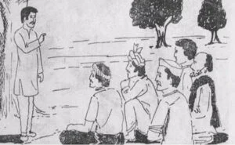
Activity Time!
Task:
Observe the picture for 30 seconds
Write a 5-line story (1 min to write)
Share the storyline in brief with peers

Slide 16
Summary
Picture Perception is a skill used to evaluate one’s thought process through images.
It improves observation, interpretation, and storytelling abilities.
Engineering students can use it to enhance communication, problem-solving, and interview readiness.
The BME Model (Beginning – Middle – End) helps in structuring a story.
Practicing with images builds confidence and creativity in expression.

Slide 17
Learning Outcomes
Define what Picture Perception is and its relevance in communication.
Sharpen observation and interpretation skills using visual prompts.
Create logical and coherent stories based on visual stimuli.
Enhance critical thinking and narrative building techniques.
Apply picture perception techniques in professional and interview scenarios.

Slide 18
Thank You

